Slide 1

Cloud Robotics
Sprint 1
Olivia Monteiro, Alicia Reed, Danny Steuer, Archer Taylor, Eli Weber
https://cs-495-cloud-robotics-team.github.io/
Notes:
Hi, we’re the cloud robotics team and this is our sprint 1 presentation. (everyone introduces themselves after this)

Slide 2
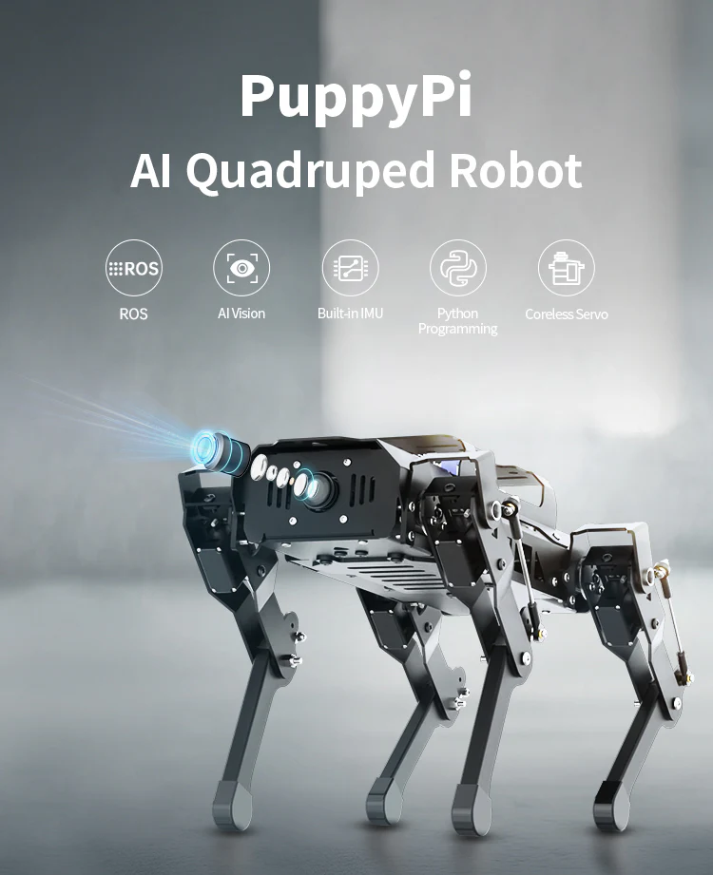
Project Focus
Provide a client-server architecture to develop educational systems to support STEM interest in K-12 students​
Use voice control to activate and control the PuppyPi
Notes:
The purpose of our project is to use the PuppyPi, which is an AI quadruped robot, to develop educational systems and support STEM interest in K-12 students. Our overarching goal for the project is to use a cloud server and AI to allow the PuppyPi to respond to voice commands, which is not a functionality it currently has.

Slide 3

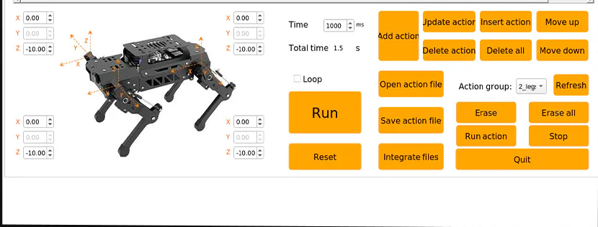
Sprint Goal
Get PuppyPi to respond to voice commands of all the basic actions on the PuppyPi app.
Notes:
Our goal for sprint 1 was to get the PuppyPi to respond to voice commands of all the basic actions on the PuppyPi app - sit, lay down, shake hands, etc.

Slide 4
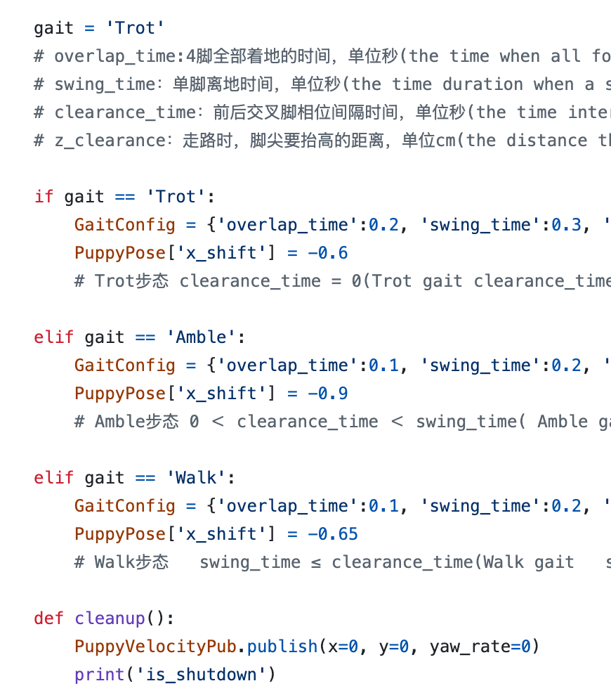
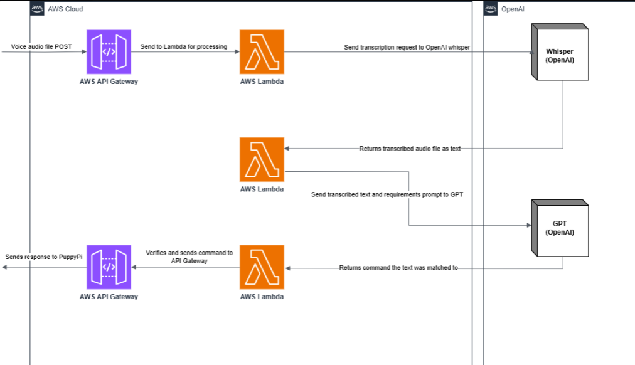
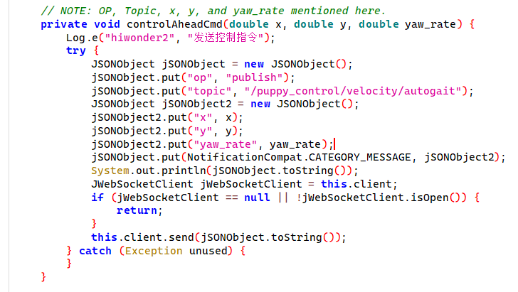
Sprint Achievements
AWS, Rest API
Decompiled App
ROS Program
Cloud server set up using AWS that recognizes voice commands.
Reverse engineered the communication methods from the PuppyPi app.
Connected to PuppyPi using VNC and ran ROS programs.
Notes:
The majority of the code in the GitHub relates to the API (archer and danny talk here). Eli, Alicia, and Olivia primarily worked on ROS programming (eli, alicia, olivia talk here).

Slide 5
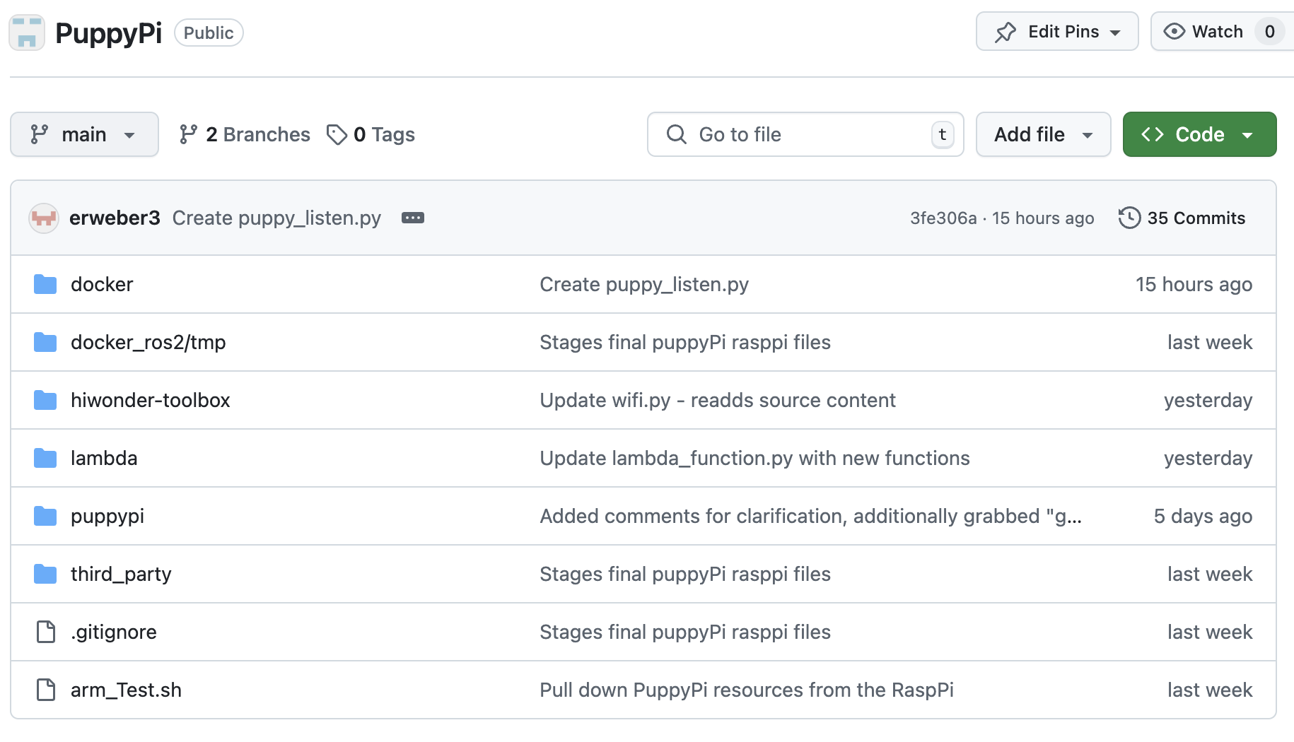
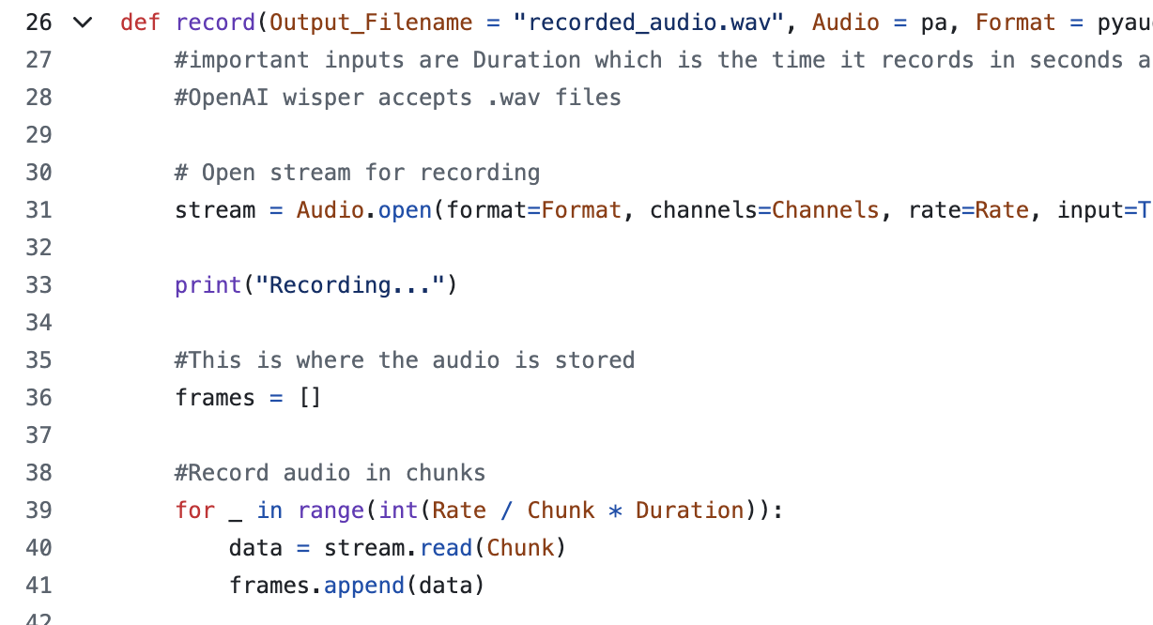
Sprint Achievements
PuppyPi CI/CD Pipeline
Voice Recognition Service
Created a CI/CD pipeline that integrates changes in the GitHub to the PuppyPi.
Trained a voice recognition model and created a recording service for PuppyPi.

Slide 6
Project & Sprint Backlog
To Do
In Progress
Completed
Configure audio stream to upload to cloud in real time
Allow for continuous listening
Reduce noise & improve latency
Integrate LIDAR, touch sensor, arm etc.
Reverse engineer/analyze PuppyPi app
Troubleshoot Docker automatic deployment
Run a ROS program with VNC
Created cloud voice transcription service & API gateway
Connected ROS and cloud to control puppyPi with audio recording
Bypassed Docker/VIM constraints
Notes:
For our project backlog, we completed the majority of our tasks. We’re still working on reverse engineering the app that came with the PuppyPi, as well as connecting the PuppyPi to GitHub for ease of coding. We also still need to finish the final steps of using the microphone on the puppyPi to record voice command audio in real time.

Slide 7
Incomplete Items & Lessons Learned
Cloud & ROS goals are mostly complete, just needs linking
We haven’t automated voice listening yet but we have made PuppyPi responsive to audio files
One of our biggest lessons was to create backups before doing anything
We set our goals high and problem-solved as a group step by step, resulting in a faster development timeframe
Sponsor (Dr. Crawford) happy with our progress
Notes:
Although we didn’t complete our overarching Sprint Goal, we finished the 2 biggest pieces leading up to that goal. Setting our expectations high and problem-solving as a team helped us to make quick progress, which our sponsor is happy with. We are hopeful to be able to have the PuppyPi respond to voice commands by the end of next sprint.

Slide 8
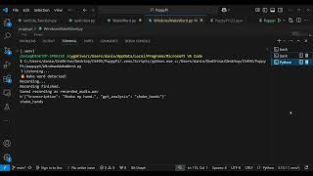
Notes:
https://youtu.be/RVPcjVpSykc

Slide 9
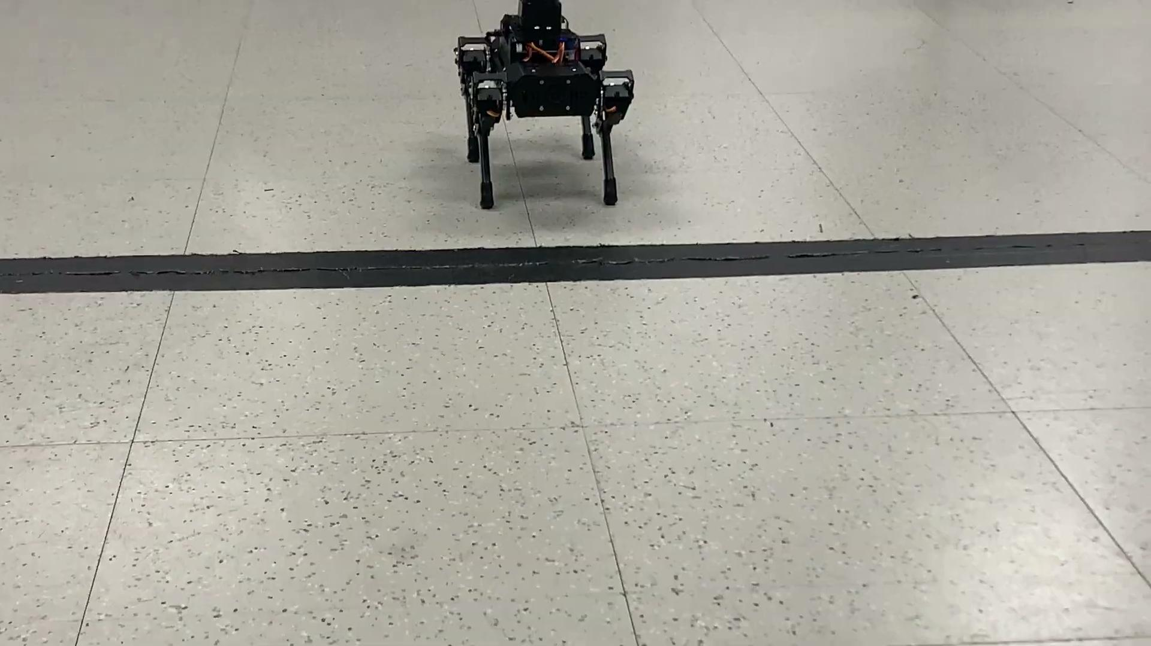
Notes:
https://youtu.be/3dXOD4ElyJI

Slide 10
Thank You!

